Slide 1
MAN & MEDICINE- TOWARDS HEALTH FOR ALL
DR. RESHMA REGHU
LECTURER,
DEPT. OF COMMUNITY MEDICINE

Slide 3
DISEASE CONTROL PHASE
1880- 1920
Control of man’s physical environment
Measures to improve the health of people due to disease
Death control

Slide 4
HEALTH PROMOTIONAL PHASE
1920- 1960
A New Concept- Health Promotion
State has direct responsibility for the health of the individual
Personal health services and public health services
Winslow defined pubic health as “the science and art of preventing disease, prolonging life and promoting health and efficiency through organized community effort”
Provision of basic health services
Community Development Programme

Slide 9
Failure of medicine
Critics of modern medicine
Increased medical cost- no increased benefit in terms of health
Advance in medical field- prevalence of certain major diseases
Expectation of life remained low – high infant and child mortality rate
Epidemiological studies shows Improvement in longevity had been achieved even before the advent of modern medicine
No equity in distribution of health service
Modern medicine is also attacked for its elitist orientation even in health systems adapted to overcome social disparities

Slide 10
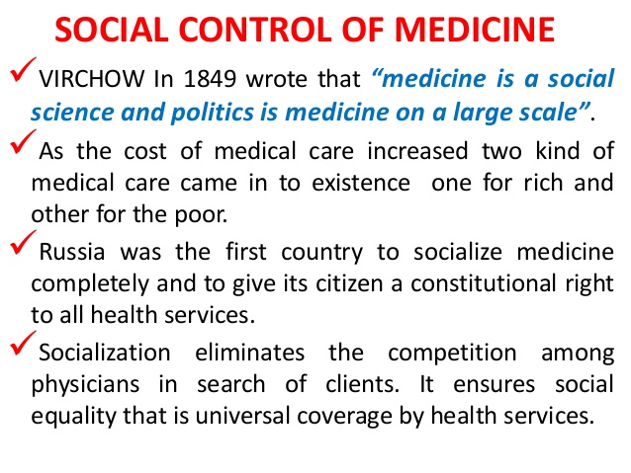

Slide 14
HEALTH CARE REVOLUTION
Services do not cover the whole population.
Lack of services in rural areas
Health is a fundamental human right
Cost of health care is rising without much improvement in their quality
Dissatisfaction with health care services

Slide 19
